Slide 1
Survey of Entering Student Engagement: A Workshop for the Oregon Community Colleges
March 4, 2010
Notes:
This PowerPoint template and Notes provide visuals and talking points you can use to customize presentations for both internal audiences (such as governing board members, faculty, staff, and students) and external audiences (such as reporters and policymakers).
The template is divided into three sections: SENSE Overview, SENSE 2008 Preliminary Findings, and Key Challenges and Next Steps. Use the section(s) that are most appropriate for the audience and objectives of your presentation.
The template presents preliminary survey findings and puts them in context. It also provides placeholders for custom slides you can create with information about your own college, its survey results, and its practices. The template includes suggestions for the types of information you can include on these customized slides. Refer to your college’s Institutional Report for the appropriate data and comparisons for your institution.
The PowerPoint template is designed to be flexible. You can:
use only the national slides, which are ready for presentation;
customize the presentation by adding local information;
add or delete slides to modify the length of the presentation and tailor it for various audiences.

Slide 2
Courtney Adkins
Survey Operations Coordinator
adkins@ccsse.org
April Juarez
College Liaison
juarez@ccsse.org
Center for Community College Student Engagement
Community College Survey of Student Engagement (CCSSE)
Community College Faculty Survey of Student Engagement (CCFSSE)
Survey of Entering Student Engagement (SENSE)
Community College Leadership Program
The University of Texas at Austin

Slide 3
Agenda
Talk about student engagement and SENSE
Share what we’ve learned about entering student engagement
Share Oregon Consortium SENSE results
Hear from Linn Benton about their SENSE experience
Take a walk through the SENSE online reporting system
Dig into college data—good news and challenges
Create college action plans

Slide 4
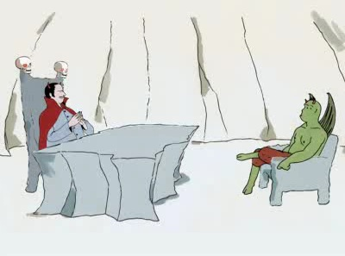
“I need someone well versed in the art of torture…
Do you know PowerPoint?”

Slide 5
Student Engagement for entering students…
how welcome a student feels at your college
how much a student prepares for class
how well a student is advised
how well a student understands his or her academic strengths and weaknesses
how often a student works with other students
how connected a student is to his or her instructor

Slide 6
What is Student Engagement?
…the amount of time and energy students invest in meaningful educational practices
…the institutional practices and student behaviors that are highly correlated with student learning and retention
Notes:
6

Slide 7
Why focus on student engagement?
  Decades of research on undergraduate student learning, persistence, and success (Tinto, Astin, McClenney, et al.)
  CCSSE Validation Study
  Qualitative research
  INSTITUTIONS can use student engagement strategies to improve student retention and learning.
Notes:
Astin-What Matters in College; Four Critical Years

Slide 8
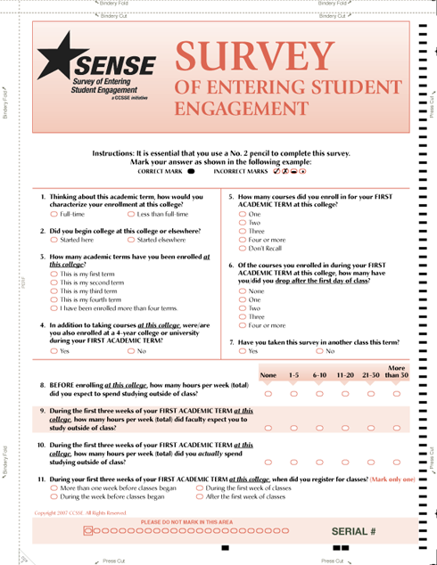
SENSE: A Tool for Improvement
  SENSE provides data that
  focus on first impressions, entering processes, classroom experiences and other special topics
  are grounded in research about what works to retain and support entering students
  identify and help colleges learn from practices that engage entering students, and
  identify areas for improvement
Notes:
An interactive bibliography linking survey items to related research is available on the SENSE web site at www.enteringstudent.org.

Slide 9
CCSSE
SENSE
Sampling Frame: All credit courses excluding lower-level ESL & Distance Learning
Random sample drawn from Course File – Actual Enrollments
In-class administration – throughout spring academic term
Reporting based on All Respondents
Sampling Frame: All developmental courses and first college-level English and math course(s) excluding lower-level ESL & Distance Learning
Random sample drawn from Course File– Projected (Maximum) Enrollments
In-class administration – 4th and 5th weeks of fall academic term
Reporting primarily based on Entering Student Respondents
Notes:
Discuss SOSE

Slide 10
SENSE Overview
Pilot: fall 2007 – 22 colleges
Field Test: fall 2008 – 89 colleges (57,547 respondents)
First National Administration: fall 2009 – 122 colleges (86,246 respondents)
Entering Student Success Institute
Initiative on Student Success – Starting Right
Benchmarks – Released spring 2010

Slide 11
SENSE at your college
I was the SENSE contact at my college.
I helped administer the survey in some way.
I will be responsible for working with the results.
I provided moral support to the process.
I mostly just complained.
I had no idea we were participating in SENSE.

Slide 12
Why focus on entering students?
  Community colleges typically lose half of their students prior to the second year
  Achieving the Dream Round One colleges (41,008 students) 14% earned NO credits during first term
  Helping students succeed through the equivalent of the first semester (12–15 credit hours) can dramatically improve subsequent success rates
Notes:
12
How many students do you know who paid and registered for classes, really didn’t want to earn any credits?

Slide 13

What We Know

Slide 14
In focus groups with students, what do they typically report as the most important factor in keeping them in school and persisting toward their goals?
#1 Relationships matter

Slide 15
Entering Students’ First Impressions of Their Colleges
The very first time I came to this college, I felt welcome.
Source: 2009 SENSE Oregon Consortium data

Slide 16


Slide 17
Colleges Meeting the Challenge
Johnson County Community College (KS)
Kilgore College (TX)

Slide 18
#2 There is a disconnect between students’ aspirations and actions
  “I still love the college experience, don't get me wrong, but it's just really so much harder than what I thought it was going to be, that's all.”
  -Female student

Slide 19
Percent of entering students who strongly agree or agree that they have the motivation to do what it takes to succeed in college:
90%
Percent of entering students who strongly agree that they are academically prepared to succeed in college:
84%
Source: 2009 SENSE Oregon Consortium data

Slide 20
Percentage of students who, at least once during their first three weeks of college:
Source: 2009 SENSE Oregon Consortium data

Slide 21
Colleges Meeting the Challenge
Asnuntuck Community College (CT)
Glen Oaks Community College (MI)

Slide 22
#3 Students don’t know what they don’t know
“They do have information available, but I found that trying to navigate their webpage is like trying to figure out a calculus problem when you have no clue what calculus is.”
-Male Student
“Students have their dreams and goals in hand, but their action plan is blank. We, as professor, educators, and staff, should be able to help them fill in the blanks.”
-Faculty Member

Slide 23
Percentage of entering students who are unaware of particular support services during their first three weeks of college:
16% of entering students unaware of a college orientation
Source: 2009 SENSE Oregon Consortium data

Slide 24
Colleges Meeting the Challenge
Austin Community College (TX)
Iowa Valley Community College District (IA)

Slide 25
#4 Students don’t do optional
How do students feel about “MANDATORY” ?
a. Frightened
b. Appreciative
c. Disgruntled
d. Rebellious
e. Depressed
Students want our guidance…
Even though they
complain
about it.

Slide 26


Slide 27
Orientation
Took part in an online orientation prior to the beginning of classes:
Attended an on-campus orientation program prior to the beginning of class:
17%
37%
Source: 2009 SENSE Oregon Consortium data

Slide 28
Of students who report knowing about the following services….the percentage of respondents who report never using them from the time of their decision to attend the college to the end of the first three weeks…
Source: 2009 SENSE National data

Slide 29
Colleges Meeting the Challenge
Coastal Bend College (TX)
Lamar Institute of Technology (TX)

Slide 30
#5 Success starts with building a Culture of Evidence
…understand the facts
…share the facts
…act on the facts

Slide 31

The Courage to See…

Slide 32
Colleges Meeting the Challenge
YOU, The Oregon Community Colleges, have started this work!
Responded to a survey of the “27 Best Practices for Student Success” outlining which colleges have initiatives in place, which are in progress, and which aren’t currently available.

Slide 33
Available to all students at 10 or more of the Oregon community colleges:
First term or first year experience
Learning centers
Developmental programs
One-stop enrollment services
Counseling and support groups
Financial aid outreach
Co-curricular activities

Slide 34
High Five!

Slide 35
But…
Mandatory Orientation is available to all students at only 9 colleges
Financial Aid Outreach is available to all students at only 10 colleges
Mandatory Advising is required of all students at only 6 colleges
Mandatory Assessment is required of all students at only 8 colleges
Notes:
What would the ROI be on retaining more students?

Slide 36
Next in the process…
Are you focusing your efforts in the right areas?
Are your efforts effective?
How do you know?
Notes:
What would the ROI be on retaining more students?
Reallocation of funds might be necessary.
“A relentless focus on a few clear priorities”

Slide 37
The SENSE Benchmarks

Slide 38
Groups of conceptually-related items
Standardized to a national mean of 50
Address key areas of entering student engagement
Provide a way for colleges to compare their own performance with other groups of colleges

Slide 39
Early Connections
High Expectations and Aspirations
Clear Academic Plan and Pathway
Effective Track to College Readiness
Engaged Learning
Academic and Social Support Network

Slide 40
2009 Oregon Consortium Benchmark Scores

Slide 41
 | Oregon Consortium | Lowest College Benchmark | Highest College Benchmark
Early Connections | 48.3 | 40.3 | 56.6
High Expectations and Aspirations | 47.2 | 42.4 | 53.6
Clear Academic Plan and Pathway | 48 | 34.4 | 57.1
Effective Track to College Readiness | 46.3 | 35 | 53.2
Engaged Learning | 51.2 | 45.9 | 58.1
Academic and Social Support Network | 48.4 | 43.8 | 52.9

Slide 42
 | Oregon Consortium | Part-Time | Full-Time
Early Connections | 48.3 | 46.2 | 52.2
High Expectations and Aspirations | 47.2 | 48.1 | 45.8
Clear Academic Plan and Pathway | 48 | 47 | 50
Effective Track to College Readiness | 46.3 | 45.2 | 48.1
Engaged Learning | 51.2 | 48.1 | 56.4
Academic and Social Support Network | 48.4 | 46.4 | 51.9

Slide 43
Looking at SENSE data, each college has specific strengths.
It’s important to:
Identify your strengths and build on them.
Target weak areas and design strategies to improve them.

Slide 44
Every program, every service,
every academic policy, every college is
perfectly designed
to achieve the exact outcome
it currently produces.

Slide 45
If nothing changes,
nothing changes.

Slide 46
Linn Benton Community College

Slide 47
The Online Reporting System

Slide 48
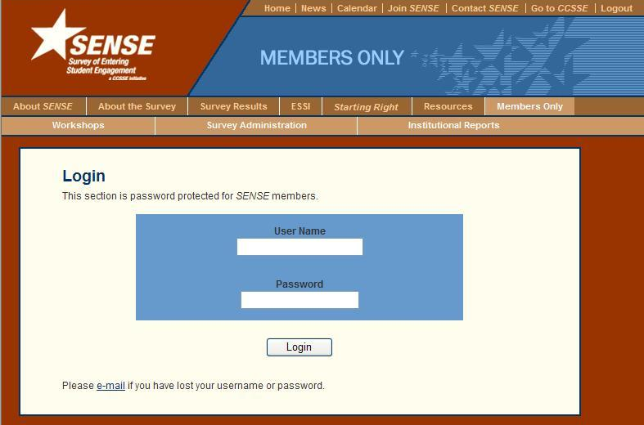
A walk through the SENSE
Members Only reporting website
Logging in with your SENSE
Username and
Password

Slide 49
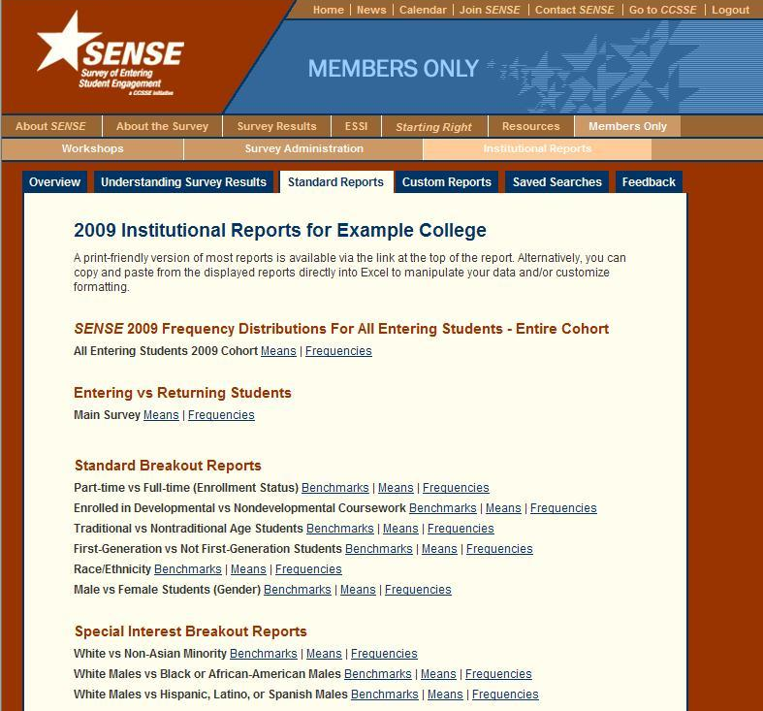
SENSE Standard Reports

Slide 50
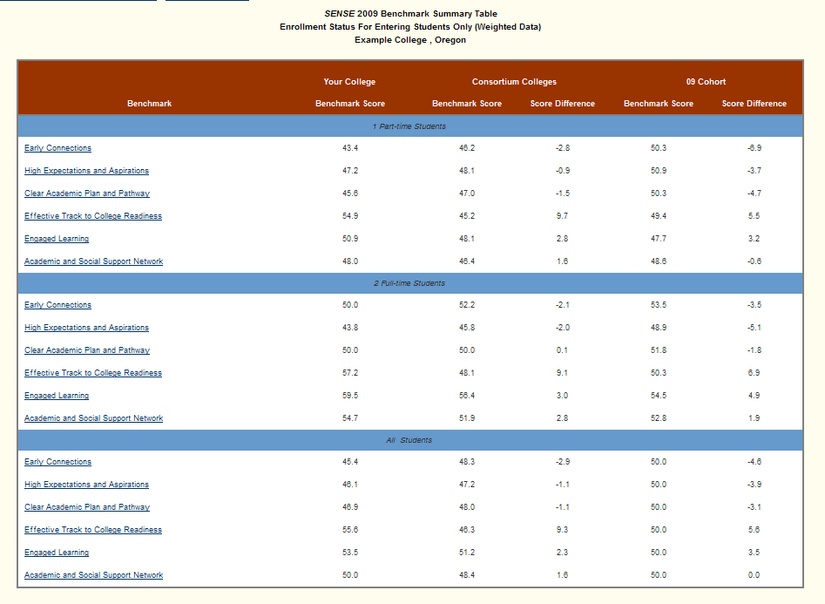
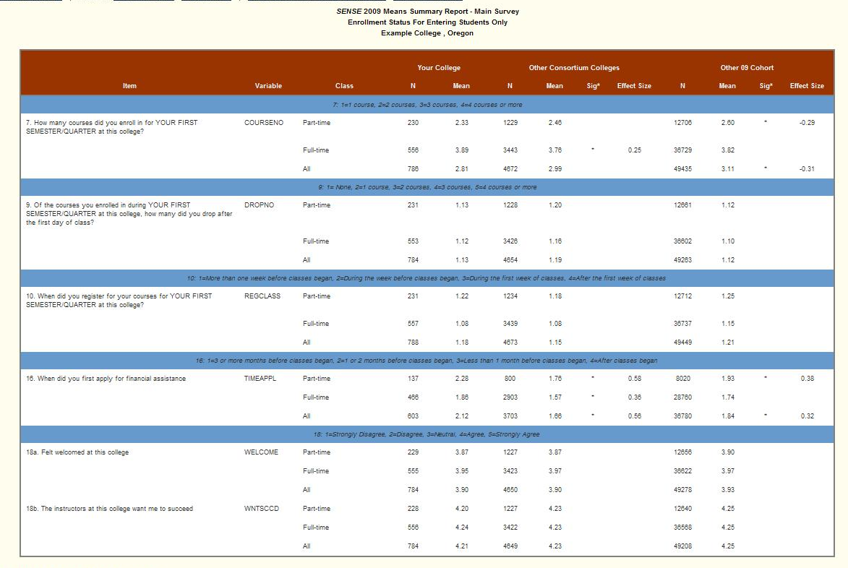
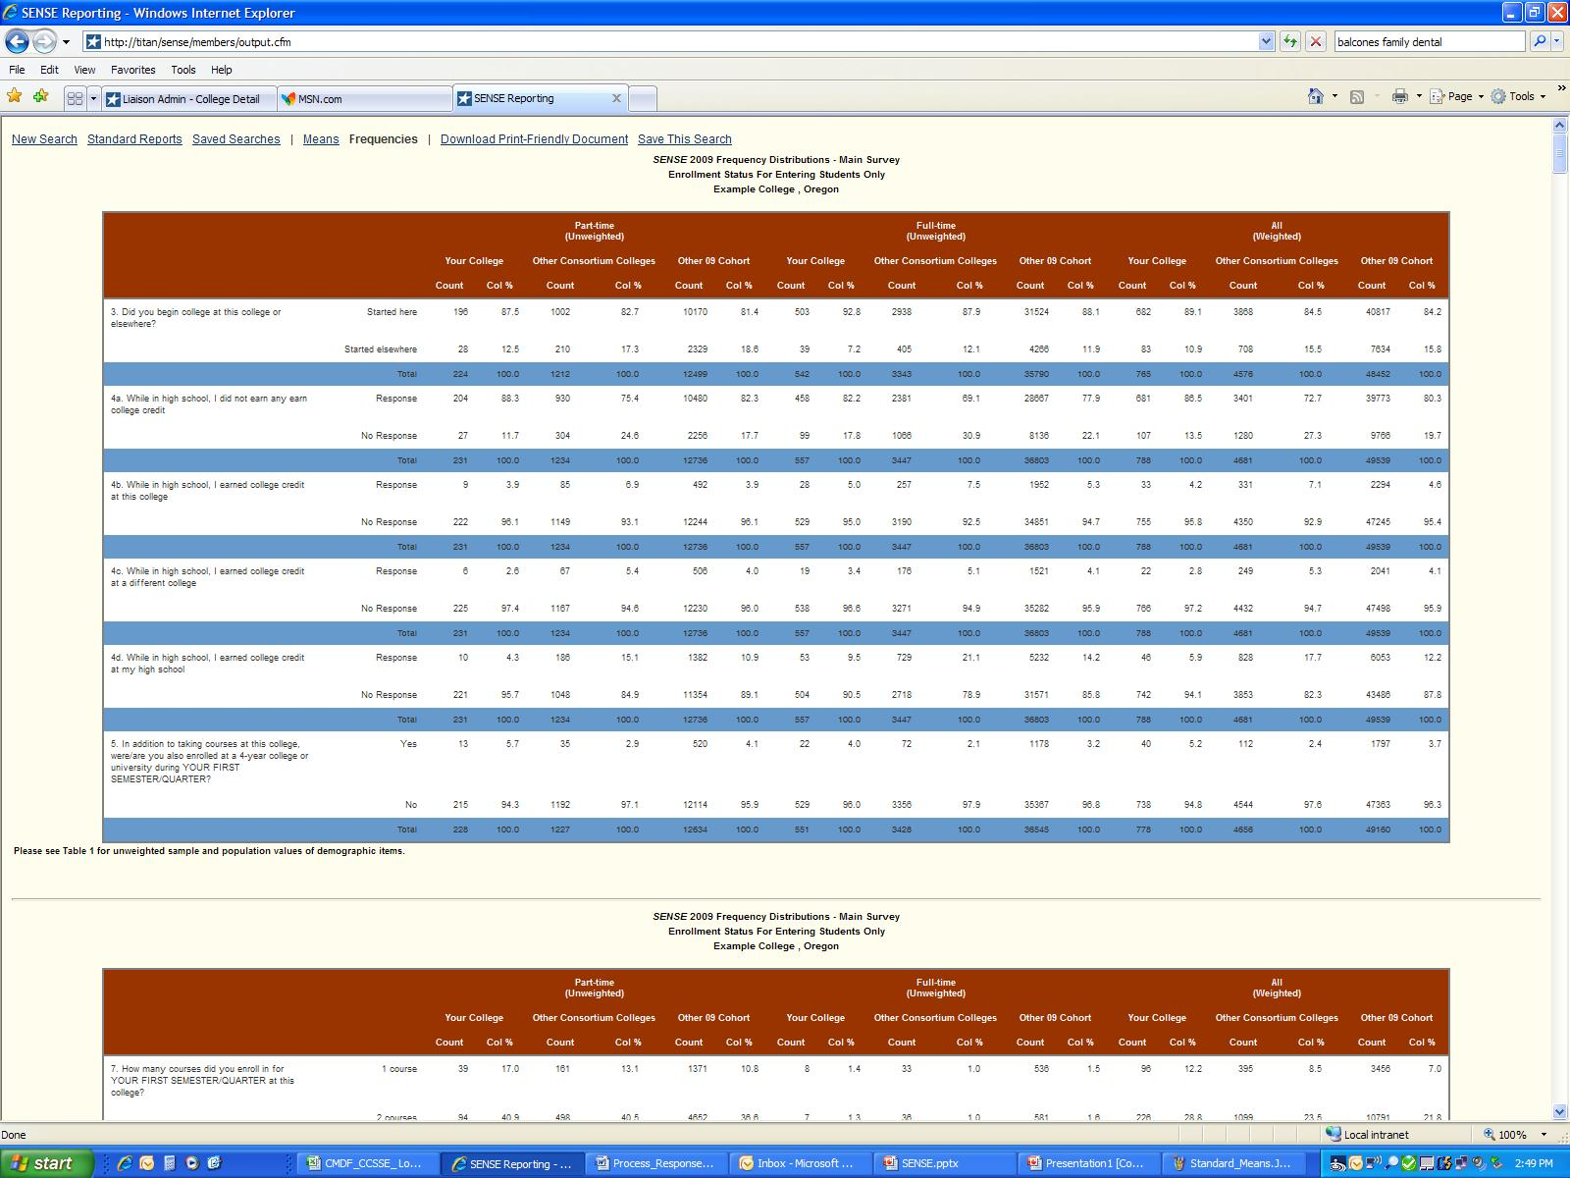
Benchmark Reports
Means Summary Reports
Frequency Distribution Reports

Slide 51
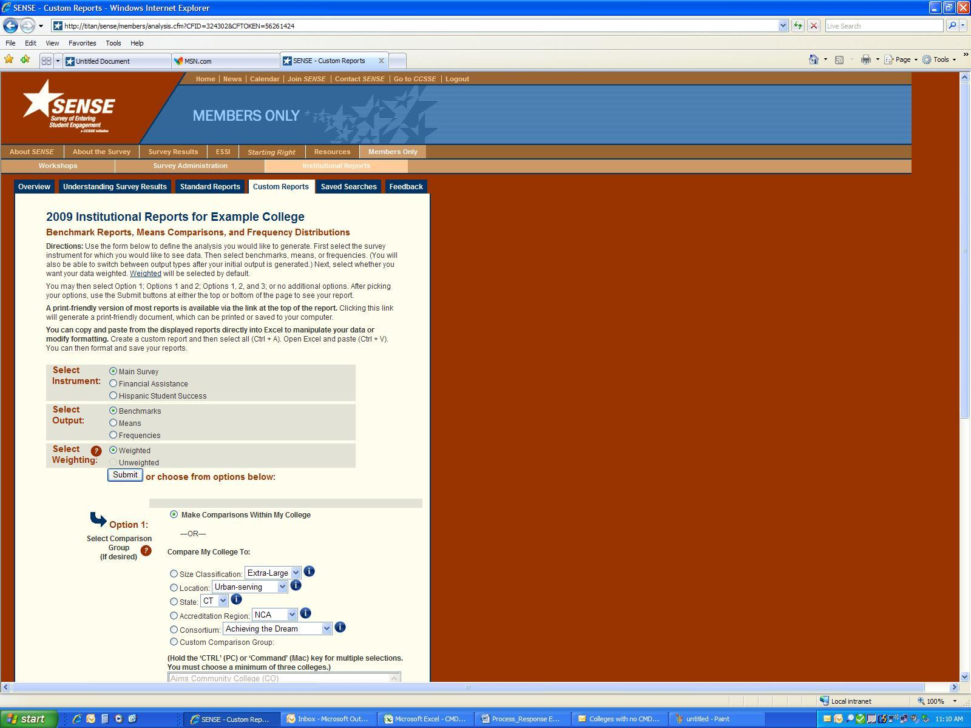
SENSE Custom Reports

Slide 52
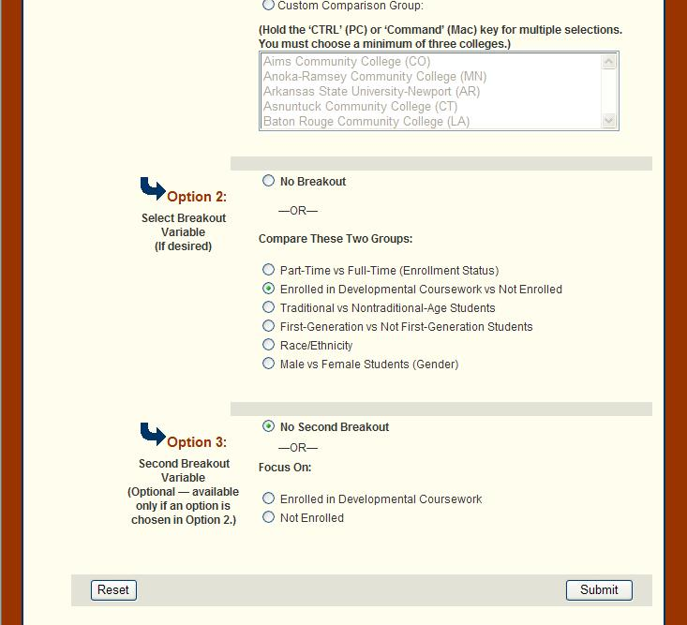
SENSE Custom Reports

Slide 53
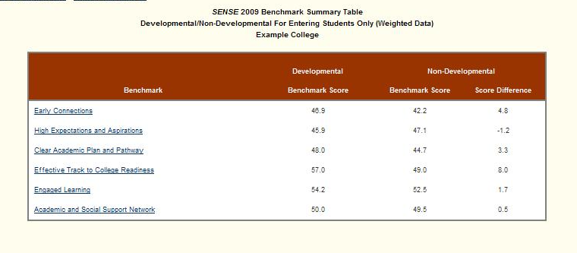
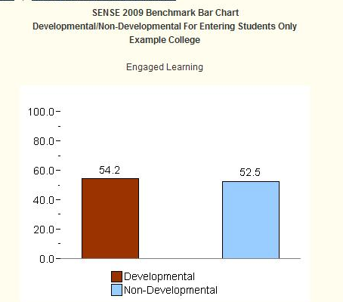

Slide 54
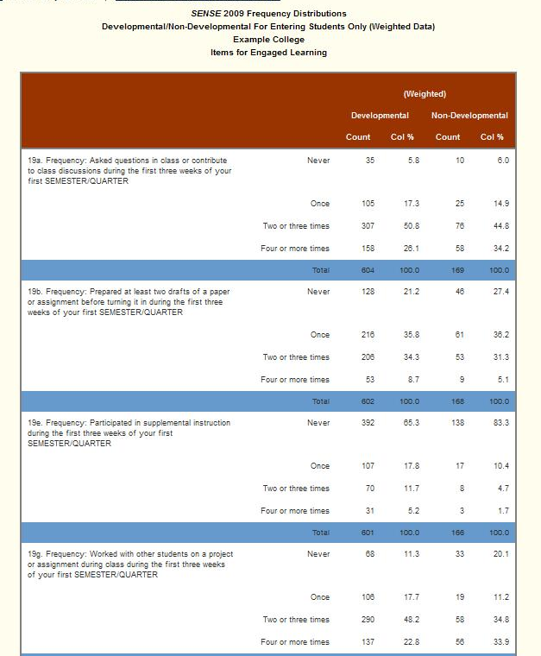
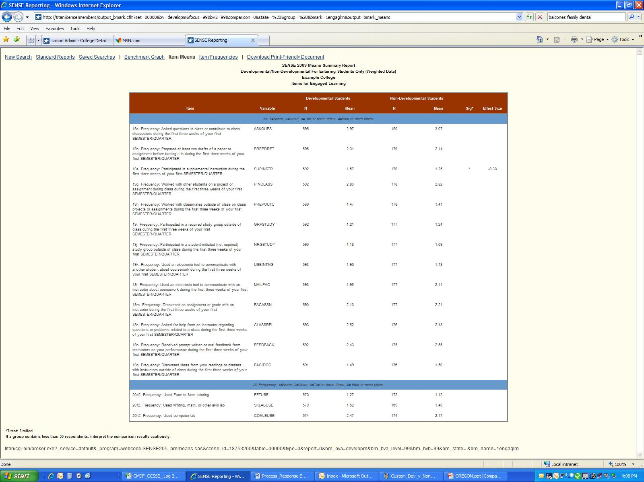

Slide 55
Online
www.enteringstudent.org

Slide 56
Digging into your data

Slide 57
College Teams Exercise
Part I:Key Findings at My College: Good News and Challenges
1. Data Review
Which benchmark score is good news?
Which benchmark score presents a challenge?
For each, which item(s) seem to be affecting the score? (Start with Means Report.)
For each, what do the student responses in the frequency table(s) tell you about this score? What is driving the score higher/lower?
2. Key Findings
Of these, what specific findings have particular pertinence to the college’s current student engagement activities/initiatives?
What is the college doing (or not doing) that could be affecting these scores?
What potential priorities for college action are presented by the data?

Slide 58
College Teams Exercise (cont.)
Key Findings at My College: Good News and Challenges
3. Potential Impact on Desired Outcomes
In addition to engagement measures, which key student outcomes might be affected by a focus on the findings identified above?
4. Additional Data Collection/ Analysis
What additional questions are raised by these data?
What additional data (quantitative or qualitative) would be useful in creating a deeper understanding of student engagement—in and out of the classroom—at the college?

Slide 59
Action Planning

Slide 60
College Teams Exercise
Identifying Opportunities to Improve Student Engagement
FIRST:
Working from your SENSE data, spend a few moments brainstorming preliminary recommendations to address the challenging score at your college.
SECOND:
Choose one of the following tasks:
Develop a plan to implement your recommendations to address the CHALLENGING SCORE at your college
Develop a plan to implement the HIGH-IMPACT/LOW-COST TACTICS previously identified

Slide 61
Group Activity:
Spend a few minutes thinking individually about entering student engagement…
On an ORANGE Post-it, write one “I want”
On a GREEN Post-it, write one “I will”
Discuss with your group. Fill out additional Post-its with new ideas generated by your discussion.
Post on the walls.
What one thing are you personally committed to do this year to improve entering student engagement?

