Slide 1
Engaging Data Displays
John Muffo
Jacki Stirn
SSBTN Consultants

Slide 2
GOALS
Review best practices
Work with examples
Provide additional resources

Slide 3
Considerations
Know your audience
Board
Faculty
Staff
Students
Public
Media

Slide 4
Tell the Story You Want To Tell
Choose your medium
Choose your tool
Be Goldilocks
Not too much data
Just the right amount
Pick an appropriate display

Slide 5
Caveats
Don’t use yellow for a text color
Just because there are a lot of fonts doesn’t mean you should use them all

Slide 6
Numbers
Use an appropriate number format
How many places before and after a decimal point ?
Use currency or percent symbols on each number or in the heading?
Other considerations ?

Slide 7
Examples for Discussion

Slide 8
THIS ?
Notes:
Even the template is distracting ? Wonder what colors will show when projected ?

Slide 9
Better ?
Notes:
Depends on the point. If the college is striving for better retention, isn’t 100% the top goal ? Was this a good choice of display ?

Slide 10
So you found a table you wanted to share…..
National Center for Education Statistics
Table A-45-3. Percentage of students seeking a certificate or associate's degree at 2-year institutions who completed a certificate or associate's degree within 150 percent of the normal time required to do so, by race/ethnicity, control of institution, and sex: Starting cohort years 2000 and 2007
Control of institution and sex | Total | White | Black | Hispanic | Asian/ Pacific Islander | American Indian/ Alaska Native
 | 2000 starting cohort
Total | 30.5 | 31.5 | 26.1 | 30.1 | 33.3 | 29.3
Public | 23.6 | 25.7 | 17.8 | 16.8 | 25.5 | 19.6
Male | 22.2 | 24.2 | 16.5 | 15.4 | 22.6 | 19.3
Female | 24.8 | 27.1 | 18.8 | 17.9 | 28.4 | 19.9
Private nonprofit | 50.1 | 49.6 | 37.5 | 56.3 | 61.4 | 62.1
Male | 49.5 | 49.3 | 31.7 | 54.3 | 62.5 | 64.5
Female | 50.7 | 50.0 | 43.1 | 58.3 | 60.1 | 60.2
Private for-profit | 59.1 | 63.1 | 47.6 | 60.3 | 64.4 | 60.3
Male | 59.3 | 63.7 | 45.6 | 58.2 | 63.1 | 55.9
Female | 58.9 | 62.6 | 48.6 | 61.8 | 65.3 | 63.8
 | 2007 starting cohort
Total | 29.9 | 29.5 | 25.3 | 33.4 | 33.6 | 25.6
Public | 20.4 | 23.0 | 11.9 | 16.0 | 25.6 | 17.4
Male | 19.9 | 22.3 | 12.0 | 15.2 | 24.0 | 18.6
Female | 20.8 | 23.7 | 11.8 | 16.8 | 27.5 | 16.5
Private nonprofit | 51.0 | 56.1 | 43.6 | 46.1 | 51.0 | 15.3
Male | 50.0 | 56.4 | 45.5 | 41.1 | 49.3 | 10.3
Female | 51.8 | 55.8 | 41.6 | 49.5 | 52.2 | 18.9
Private for-profit | 60.3 | 65.0 | 49.2 | 64.9 | 68.5 | 59.2
Male | 58.3 | 65.3 | 44.6 | 59.3 | 66.3 | 56.9
Female | 61.3 | 64.8 | 50.8 | 67.3 | 69.8 | 60.2
NOTE: The graduation rate was calculated as the total number of students who completed a degree within 150 percent of the normal time to degree attainment divided by the number of students in the revised cohort (i.e., the cohort minus any allowable exclusions). For this indicator, the revised cohorts are the spring 2011 estimates of the number of students who entered a 2-year institution in fall 2007 and the spring 2003 estimates for the number of students who entered a 2-year institution in fall 2000 as first-time, full-time undergraduates seeking a certificate or associate’s degree. Students who transferred to another institution and graduated are not counted as completers at their initial institution. Included in the totals, but not shown separately, are estimates for persons with unknown race/ethnicity and nonresident aliens. Race categories exclude persons of Hispanic ethnicity. For more information on race/ethnicity and classification of postsecondary education institutions, see Appendix C − Commonly Used Measures. For more information on the Integrated Postsecondary Education Data System (IPEDS), see Appendix B − Guide to Sources.
SOURCE: U.S. Department of Education, National Center for Education Statistics, Integrated Postsecondary Education Data System (IPEDS), Spring 2004 and Spring 2011, Graduation Rates and Institutional Characteristics components.
Notes:
Restrain yourself and be sure to view your displays from the perspective of the audience

Slide 11
Choose Display Carefully
Notes:
Would you ever use this ? For what ? (DISCUSS)

Slide 12
Use the appropriate and same scale
Notes:
This is pertaining to a page with several graphs of the same style.

Slide 13
Tables
CREDENTIALS (THREE-YEAR GRADUATION RATE) COHORT DATA
COHORT | FT COHORT GRAD | PT COHORT GRAD | OVERALL COHORT GRAD | FT EFC 6109+ GRAD | PT EFC 6109+ GRAD | OVERALL EFC 6109+ GRAD | FT EFC 0-2477 GRAD | PT EFC 0-2477 GRAD | OVERALL EFC 0-2477 GRAD | DISPARITY (% POINTS)
2007 | 30.6% (130/425) | 14.9% (27/181) | 25.9% (157/606) | 51.4% (37/72) | 33.3% (9/27) | 46.5% (46/99) | 24.0% (60/250) | 9.6% (9/94) | 20.1% (69/344) | 26.4
2008 | 28.5% (142/498) | 16.5% (27/164) | 25.5% (169/662) | 50.0% (52/104) | 25.9% (7/27) | 45.0% (59/131) | 20.8% (62/298) | 16.9% (14/83) | 19.9% (76/381) | 25.1
2009 | 26.0% (137/527) | 13.9% (28/201) | 22.7% (165/728) | 37.0% (34/92) | 20.0% (7/35) | 32.3% (41/127) | 23.6% (83/352) | 10.9% (12/110) | 20.6% (95/462) | 11.7
Notes:
Use to discuss displaying cohort data and way to much in one table

Slide 14
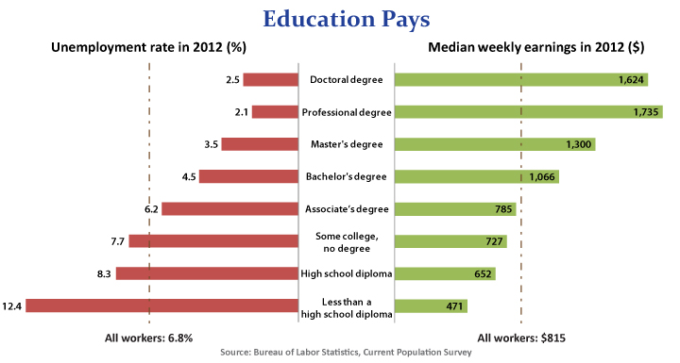
Thoughts ?

Slide 15
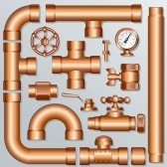
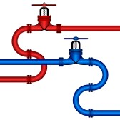
Just for fun
Part and full time
students on track
Your Data

